Slide 1
Data and Features
PCS 703: Machine Learning
Yawar Azad

Slide 2
Plan for today
Types of ML problems
Typical workflow of ML problems
Various perspectives of ML problems
Data and Features
Some basic operations of data and features
People who need a math refresher can use this handy tutorial

Slide 3
A Loose Taxonomy of ML
Learning using labeled data
Learning using unlabeled data
Some examples of
supervised learning problems
Classification
Regression
Ranking
Supervised
Learning
Unsupervised
Learning
Some examples of
unsupervised learning problems
Clustering
Dimensionality Reduction
Unsupervised Probability Density Estimation
Machine Learning
Many other specialized flavors of ML also exist,
some of which include
Semi-supervised Learning
Active Learning
Transfer Learning
Multitask Learning
Imitation Learning (somewhat related to RL)
Zero-Shot Learning
Few-Shot Learning
Continual learning
RL doesn’t use “labeled” or
“unlabeled” data in the traditional sense! In RL, an agent learns via
its interactions with an environment
Reinforcement Learning

Slide 4









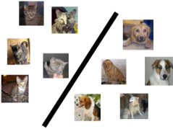
A Typical Supervised Learning Workflow
Note: This example is for the problem of binary classification, a supervised learning problem
Labeled
Training
Data
“dog”
“dog”
“dog”
“dog”
Can you think of a problem you would try to solve using supervised learning?
“dog”
“cat”
“dog”
“cat”
“Feature”
Extraction
“cat”
ML Algorithm
(outputs a “model”)
“cat”
“cat”
“cat”
Feature extraction converts raw inputs to a numeric representation that the ML algo can understand and work with. More on feature extraction later.
Predicted Label
(cat/dog)
Test
Image
“Feature”
Extraction
Cat vs Dog
Prediction model
https://www.pinclipart.com/, http://www.pngtree.com

Slide 5
A Typical Unsupervised Learning Workflow
Note: This example is for the problem of data clustering, an unsupervised learning problem
Unlabeled
Data
“Feature”
Extraction
ML Algorithm
(outputs a clustering)
https://www.pinclipart.com/, http://www.pngtree.com

Slide 6




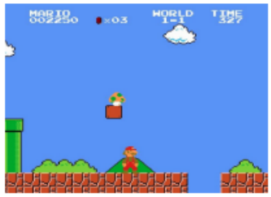
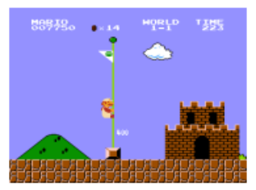
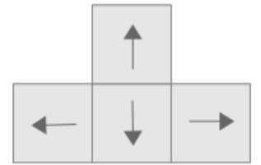


A Typical Reinforcement Learning Workflow
Wish to teach an agent optimal policy for some task
Agent does the following repeatedly
Senses/observes the environment
Takes an action based on its current policy
Receives a reward for that action
Updates its policy
Agent’s goal is to maximize its overall reward
Agent State
Observation
Reward
Action
There IS supervision, not explicit (as in Supervised Learning) but rather implicit (feedback based)
Environment State at time t

Slide 7
ML: Some Perspectives

Slide 8
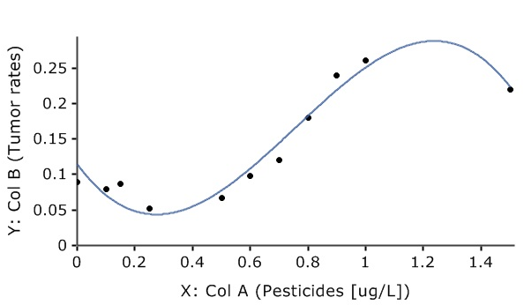
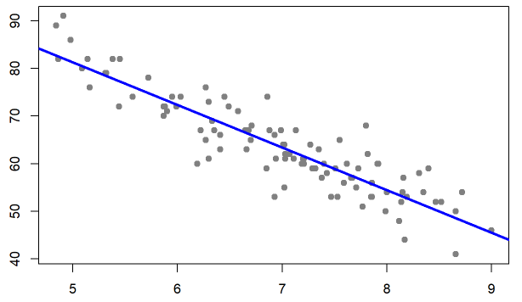
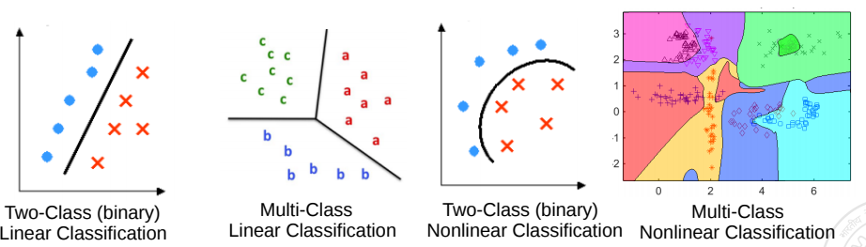
Geometric Perspective
Recall that feature extraction converts inputs into a numeric representation
Basic fact: Inputs in ML problems can often be represented as points or vectors in some vector space
Doing ML on such data can thus be seen from a geometric view
Regression: A supervised learning problem. Goal is to model the relationship between input (x) and real-valued output (y). This is akin to a line or curve fitting problem
y: Grumpiness (scale of 0-100)
x: sleep hours
Classification: A supervised learning problem. Goal is to learn a to predict which of the two or more classes an input belongs to. Akin to learning linear/nonlinear separator for the inputs
Pic from: https://learningstatisticswithr.com/book/regression.html, https://maxstat.de/

Slide 9

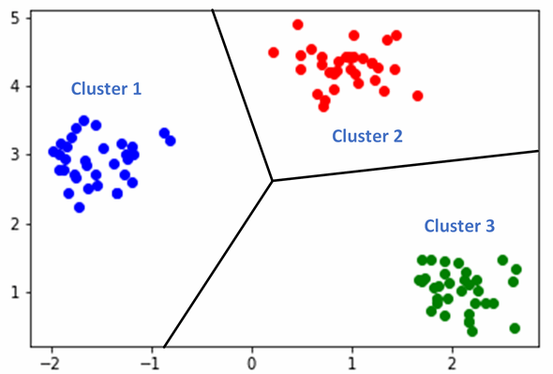
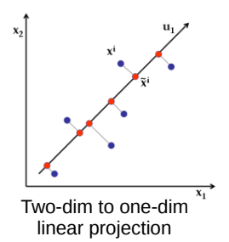
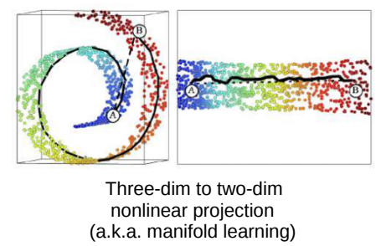
Geometric Perspective
Clustering looks like classification to me. Is there any difference?
Clustering: An unsupervised learning problem. Goal is to group inputs in a few clusters based on their similarities with each other
Yes. In clustering, we don’t know the labels. Goal is to separate them without any labeled “supervision”
Dimensionality Reduction: An unsupervised learning problem. Goal is to compress the size of each input without losing much information present in the data

Slide 10
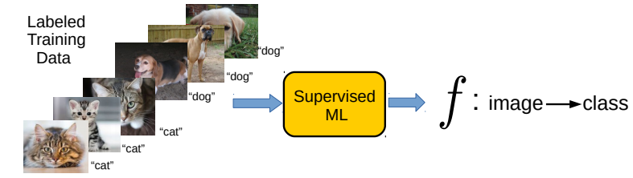
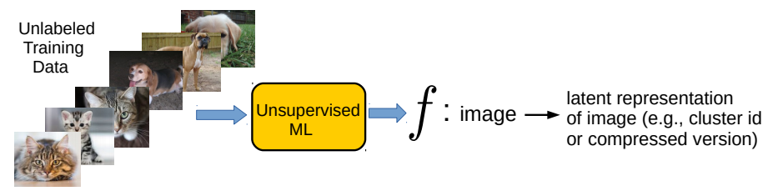
Perspective as function approximation
Supervised Learning (“predict output given input”) can be usually thought of as learning a function f that maps each input to the corresponding output
Unsupervised Learning (“model/compress inputs”) can also be usually thought of as learning a function f that maps each input to a compact representation
Reinforcement Learning can also be seen as doing function approximation
Harder since we don’t know the labels in this case

Slide 11
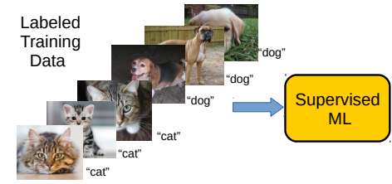
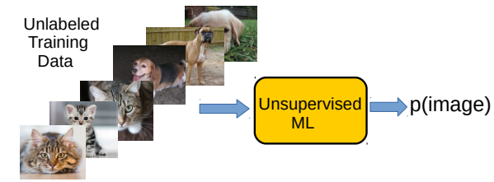
Perspective as probability estimation
Supervised Learning (“predict output given input”) can be thought of as estimating the conditional probability of each possible output given an input
Unsupervised Learning (“model/compress inputs”) can be thought of as estimating the probability density of the inputs
Reinforcement Learning can also be seen as estimating probability densities
p(label=“cat” | image)
Harder since we don’t know the labels in this case

Slide 12
Data and Features

Slide 13
Data and Features
ML algos require a numeric feature representation of the inputs
Features can be obtained using one of the two approaches
  Approach 1: Extracting/constructing features manually from raw inputs
  Approach 2: Learning the features from raw inputs
Approach 1 is what we will focus on primarily for now
Approach 2 is what is followed in Deep Learning algorithms (will see later)
Approach 1 is not as powerful as Approach 2 but still used widely

Slide 14
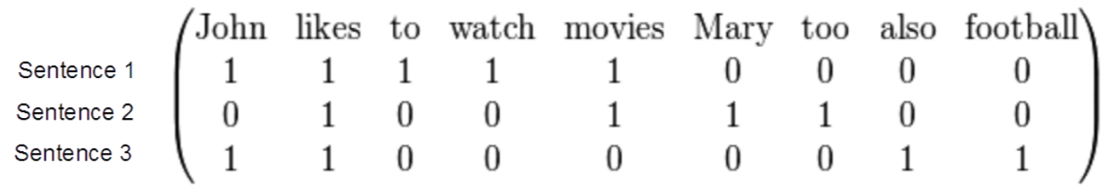
Example: Feature Extraction for Text Data
Consider some text data consisting of the following sentences:
  John likes to watch movies
  Mary likes movies too
  John also likes football
Want to construct a feature representation for these sentences
Here is a “bag-of-words” (BoW) feature representation of these sentences
Each sentence is now represented as a binary vector (each feature is a binary value, denoting presence or absence of a word). BoW is also called “unigram” rep.
BoW is just one of the many ways of doing feature extraction for text data. Not the most optimal one, and has various flaws (can you think of some?), but often works reasonably well

Slide 15
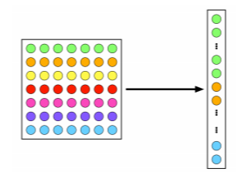

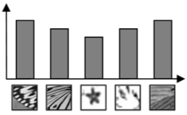
Example: Feature Extraction for Image Data
A very simple feature extraction approach for image data is flattening
Histogram of visual patterns is another popular feature extr. method for images
Many other manual feature extraction techniques developed in computer vision and image processing communities (SIFT, HoG, and others)
Flattening and histogram based methods destroy the spatial information in the image but often still work reasonably well
7x7 image
(49 pixels)
Vector of pixel
intensities
Pic credit: cat.uab.cat/Research/object-recognition

Slide 16
Feature Selection
Not all the extracted features may be relevant for learning the model (some may even confuse the learner)
Feature selection (a step after feature extraction) can be used to identify the features that matter, and discard the others, for more effective learning
Many techniques exist – some based on intuition, some based on algorithmic principles (will visit feature selection later)
More common in supervised learning but can also be done for unsup. learning
Age
Gender
Height
Weight
Eye color
Body-mass index (BMI)

Slide 17
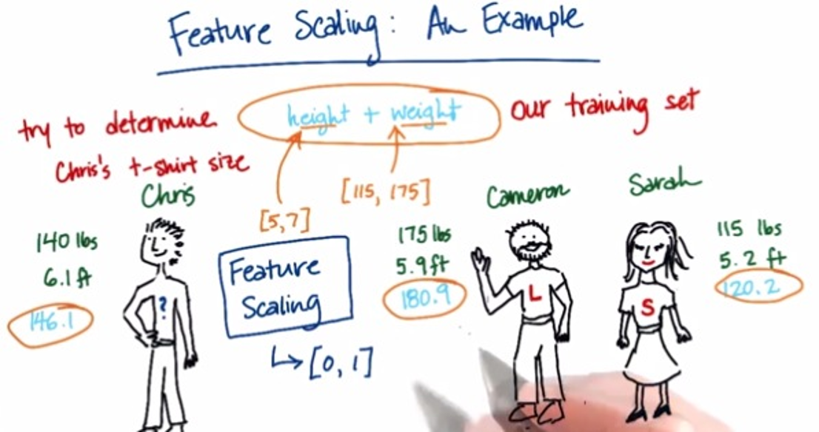
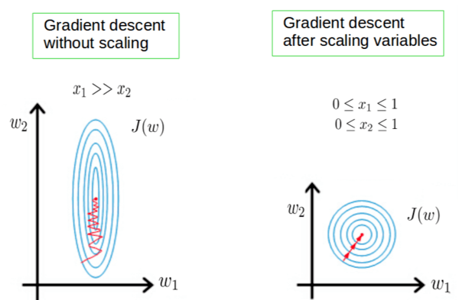
Some More Postprocessing: Feature Scaling
Even after feature selection, the features may not be on the same scale
This can be problematic when comparing two inputs – features that have larger scales may dominate the result of such comparisons
Therefore helpful to standardize the features (e.g., by bringing all of them on the same scale such as between 0 to 1)
Also helpful for stabilizing the optimization techniques used in ML algos
Pic credit: https://becominghuman.ai/demystifying-feature-scaling-baff53e9b3fd, https://stackoverflow.com/

Slide 18
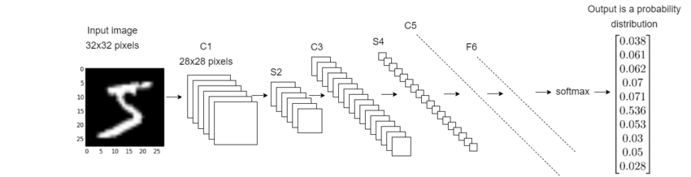
Deep Learning: An End-to-End Approach to ML
Deep Learning = ML with automated feature learning from the raw inputs
Feature extraction part is automated via the feature learning module
Classification Model Learning
Feature Learning Module
(one or more layers_
Raw Input
Learned Features
(penultimate layer)
Pic an adaptation of the original from: https://deepai.org/

Slide 19
Next Class
Introduction to Supervised Learning
A simple Supervised Learning algorithm based on computing distances

Slide 20
References
https://www.cse.iitk.ac.in/users/nsrivast/CS771/lec02.pptx

